Slide 2
30 Active Minutes: Challenges, Initiatives and Best Practice
St Stephens C of E Primary School
Beacon Primary School
Jim Morris
Development Manager
Youth Sport Trust
jim.morris@youthsporttrust.org @JimMorris_YST

Slide 3
Active 30 Minute Rationale

Slide 4
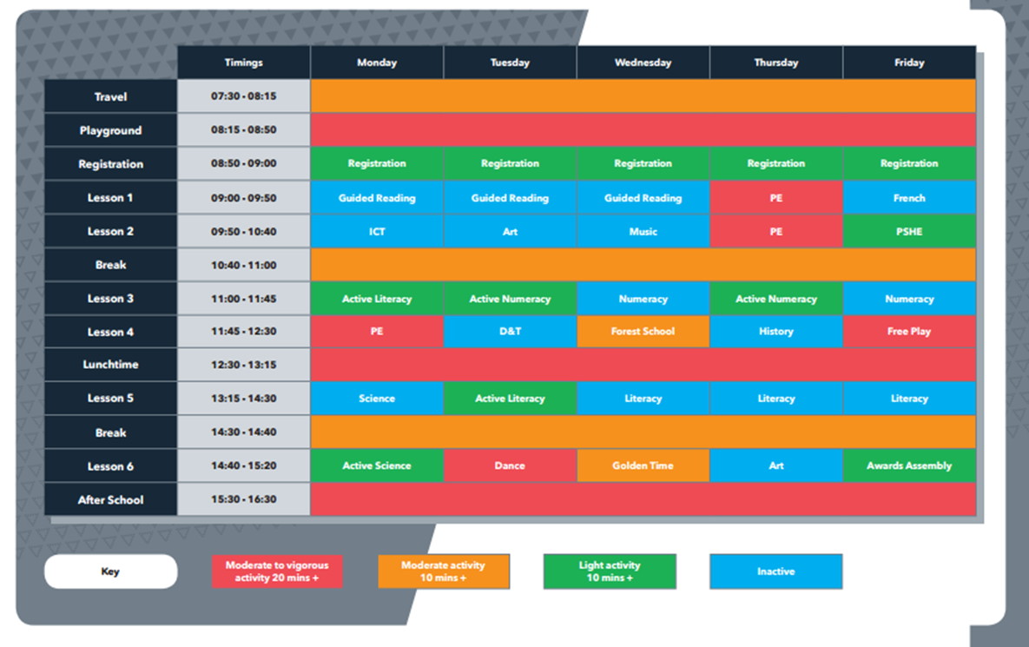

Slide 5
Physical and Emotional Wellbeing

Slide 6
Insanity: doing the same thing over and
over again and expecting different results
Albert Einstein

Slide 7
St Stephen’s and the Active 30.
At St Stephen’s our intent is for all of our children to know: ​The effect a healthy lifestyle has on their bodies and how it impacts on their participation in sport. All children have a good understanding of physical literacy
David Woollatt

Slide 8
St Stephen’s C of E Primary.
School context:
- The proportion of pupils eligible for FSM/ever 6 is well above the national picture (50.7% v 23.5%).
- The proportion of pupils with English as an additional language is well above the national picture (55.5% v 20.9%).
- The proportion of pupils with SEN support and with a statement or EHC plan is broadly in line with the national picture (12.2% v 12.4%/ 0.8% v 1.4%).
- The proportion of pupils who remain at school is much lower 77.6% than National 85.8%
- The school has 15 out of 17 possible ethnic groups.
- The school is situated in a highly deprived area 0.44
'We will not make excuses, we will not make false promises, but we will insist that all children have the same life chances and opportunities’.

Slide 9
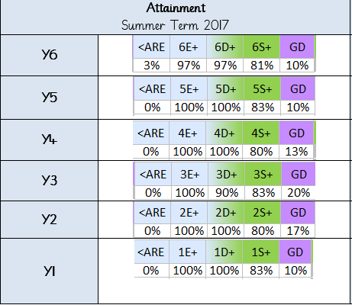
PE data summer 2017/ 2018.
In depth data for PE and games gives us a unique opportunity to analyse where our children’s levels of physical literacy lie as stated in our Intent for PE.
For children who are working below age related expectations we can accurately pin point who they are and understand the story behind why they are not at the standard level.
Consequently sport premium spending, CPD and intervention can then be targeted to these children ensuring negative trends do not become embedded across school.
A school trend of girls participation and therefore attainment being low was identified through this data.
So how did we effectively use our Sports premium money in this instance?
How did we use active 30 to benefit these children?

Slide 10
Data informing change: Impact!
Issue: Girls engagement and attainment dipped
How did we use our sports premium money effectively to enable change?
This was signposted in data. Assessment of all foundation subjects in depth ensures we can identify need and tailor provision to meet the needs of our children.
Sports Premium money was then used to run a lunch time girls football club. Therefore the girls who were targeted across school were engaged in this.
Impact
Attainment data has shown gap towards ARE has closed or is closing at a rate identified as better than expected progress.
Self esteem of the children has improved as well as fitness. This has been evidenced within termly pupil voice.
“I love going to the lunchtime football group, it is always fun and now I am better at football than most of the boys!“ Year 6 pupil.

Slide 11
What was our starting point for active 30?
The active lives survey is a great initiative to gain information about large proportions of your children in school about: Wellbeing, enjoyment of physical activity as well as participation and activity levels during the day.
This information can then be used to inform planning and targeted intervention where required.
This information allowed us to understand our curriculum was tailored and pitched correctly for our children.

Slide 12
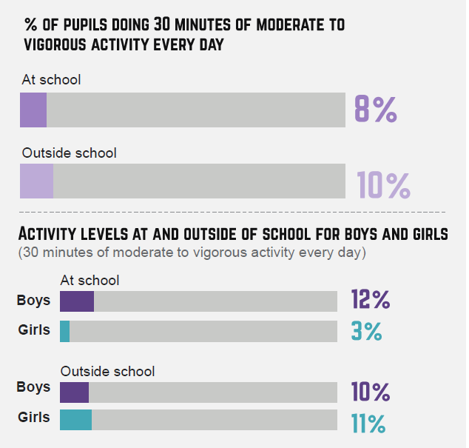
How do we review our action plan for the coming year?
Where we identified need we were able to act.
How did we act?
We used the sports premium funding to create lunch time intervention groups (girls/SEN). The coaches we employ at lunchtime run active sports lunch times, which are timetabled to ensure a range of activities.
2. Using the active schools planner which identifies sedentary behaviour in class rooms by grading hot through to cold we saw our hall was very cold in the morning (no use) so…
3. We trained staff to deliver active literacy before school to make use of the hall space we had and to ensure more children were able to not only get their active 30 minutes in school but also their daily 60 minutes as per guidelines. As well as target children who are SEN.

Slide 13
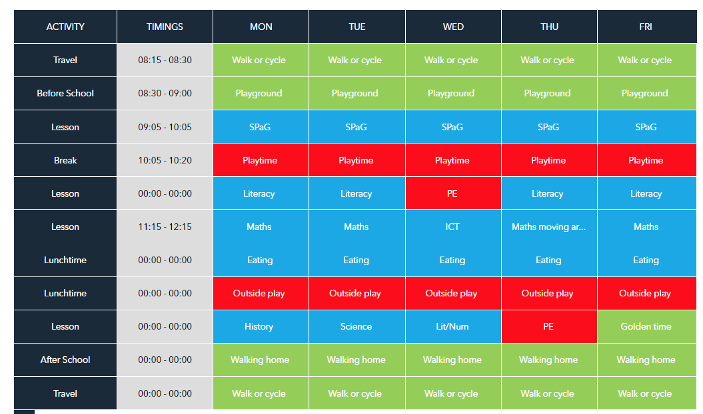
Active schools planner
Year 3:
After our feedback from the active lives survey we conducted the active schools planner heat map.
In year 3 for example we identified sedentary behaviours throughout the day.
To combat this we embedded a policy of ensuring we have ‘yellow’ lessons in literacy and maths at least once a week.
Also we warmup for the day, active body active mind

Slide 14
As you can see the difference has been profound on activity levels.
Impact
Physical activity levels across school have improved
PE data is at an all time high across school at 86%
Year 3:

Slide 15
How have we warmed up our classes to ensure we have our active 30?
Active literacy/maths – Used in the hall to prevent the space being ‘cold’.
Cool Kids programme – For SEN learners and children with motor skill development issues.
BBC super movers videos – As a learning tool they use dance to embed concepts.
Just dance – As warm up tool in class using YouTube.
Practical active lessons – Ensuring children are out of their chair during the lesson preventing the sedentary behaviours an inactive lesson promotes.

Slide 16
Thank you very much for listening, time for questions.

Slide 17
Dan Johns
PE Coordinator

Slide 18
Who we are . . .
Beacon Primary School is a larger than average primary school with currently 494 pupils on roll.
Beacon Primary school is based in Willenhall in a heavily deprived area.
58% of children are pupil premium
We are above average for disadvantaged children and the support we receive from pupil premium is higher than average.
High obesity level in area

Slide 19
Results
2013/14 – Beacon was in the bottom 15% of all schools nationally in attainment.
NOR- 302
2017/18 - Beacon is in the top 10% of all schools nationally in attainment.
In the top 3% in the country for progress.
Above National in all areas of the Primary Phase
NOR - 472
Ofsted - Good

Slide 20
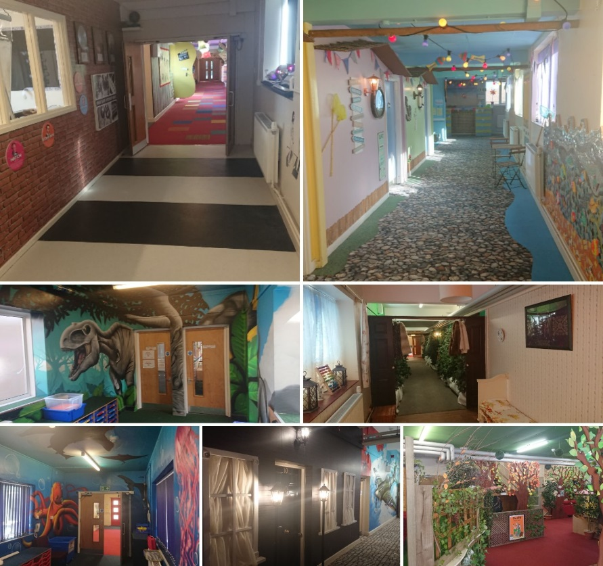
Whole school development
Active environment

Slide 21
Whole school development
Active school – environment
Specialist sports coaches
PE kits
2 hours of PE per week for every child from Reception to Year 6 (1 hour a week for nursery)
Broad range of activities in PE
Active lessons – Active maths and Active literacy
After school sport clubs – 10 per week
Magic mile
Play leaders
Kid active monitoring

Slide 22
KS1 Games and PE
KS1 Games
Team Games
Movement
Space awareness
Decision making
Hand eye co-ordination
Rolling
Throwing and catching
Sports - Introductions
Competition – House games
3 step coaching for games
Try it
Coach it
Progress it
All games sessions are fast paced and designed to have a competitive edge.
KS1 PE
Dance – split into 2 parts
Routine to be performed on stage
Expression through dance
Gymnastics –
Body control
Travelling across a mat
Jumps
Sequences
Athletics –
Running games
Sports day preparation
PE lessons are slower paced, more technical lessons.

Slide 23
KS2 Games and PE
KS2 Games
Topics - Netball, Football, Hockey, Cricket, Rounders, Basketball, Rugby, Dodgeball, SAQ
Yr 3/4 team building games
Changeable
International week – Kabaddi, Sumo wrestling, Bandi, American Football, Petanque, Volleyball
3 step coaching for games
Try it
Coach it
Progress it
All games sessions are fast paced and designed to have a competitive edge.
KS2 PE
Dance –
Routine to be performed on stage
Yr 3/4 introduction into other styles
Yr 5/6 create their own routine
Gymnastics –
Body control
Travelling across a mat
Jumps
Point balances
Building routine in pairs (yr3/4) or groups (yr5/6)
Athletics –
Traditional events
PE lessons are slower paced, more technical lessons.

Slide 24
EYFS Games and PE
RECEPTION Games
Fundamentals
Spatial awareness
Being able to follow instructions
Taking turns
Independence
RECEPTION PE
Dance
Gymnastics
Running Games
NURSERY PE
Fundamentals
Spatial awareness
Expression
Fine motor skills
Nursery lessons a taught once a week with 40mins of structured PE followed by 20mins of either dance or free play with the PE equipment
EYFS lessons are much slower paced and can often take two weeks to make sure children show understanding

Slide 25
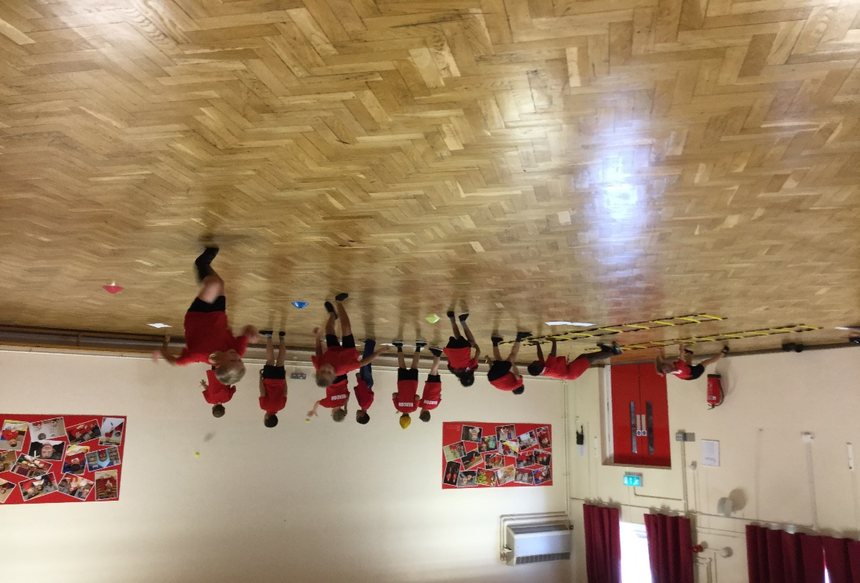
Kid Active
5 activities.
1 minute for each activity
5 key areas;
Speed/stamina
Agility
Core strength
Upper body strength
Hand/eye co-ordination
6 times a year - every half term
Peer scored
100% improvement for 2016/17
and 2017/18
Reward system

Slide 26
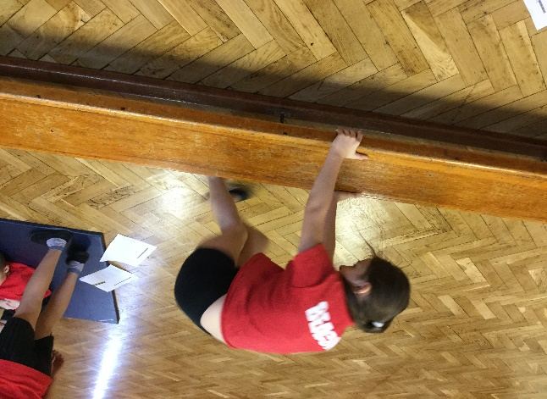
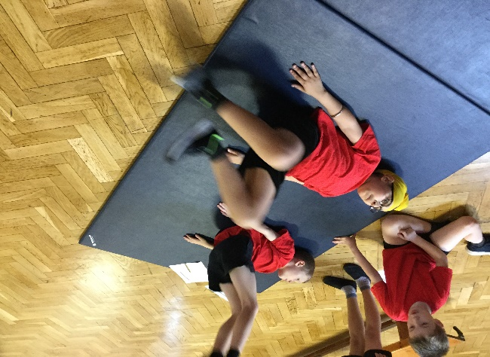
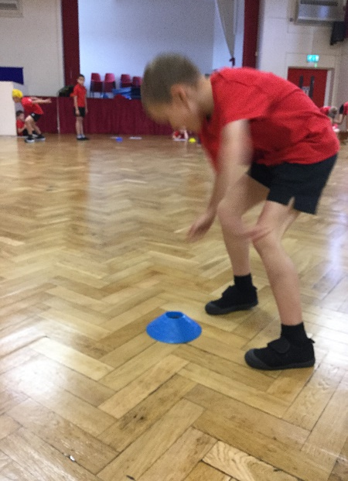
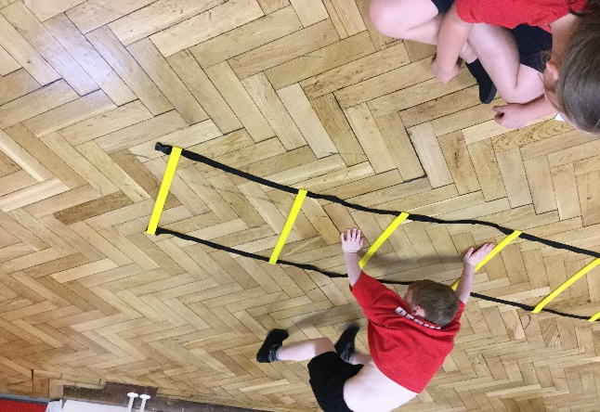
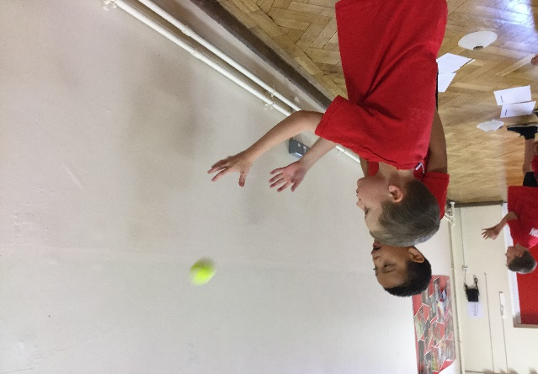
Kid Active
Speed Bounce
Up Downs
Wall
Catch
Shuttle Runs
Ladder Walks

Slide 27
Assessments and monitoring
Fitness monitoring

Slide 28
PE Ofsted findings
Pupils benefit greatly from a broad and often exciting curriculum. They enjoy good extra-curricular activities, especially in sport.
The school’s work to promote pupils’ personal development and welfare is outstanding. Leaders take a well-coordinated approach to all aspects of pupils’ welfare. They ensure that pupils are safe, and promote physical fitness, healthy eating and emotional wellbeing most effectively. Staff use their detailed knowledge to encourage and nurture all pupils, especially the most vulnerable.
Pupils benefit from a broad curriculum, which places due weight on knowledge and skills in a wide range of subjects in addition to English and mathematics. Trips to places of interest, such as the theatre or Warwick Castle, and themed days add to pupils’ engagement with their work. A number of extra-curricular activities, largely in sport, further enhance pupils’ learning.
Leaders have identified the importance of physical fitness in a neighbourhood where levels of obesity have been particularly high. In response, they have successfully promoted competitive sport, and require each class to walk at least a mile every day. Pupils understand the benefits of healthy eating, and increasing numbers are eating healthily at lunchtime. The school also runs after-school classes which show pupils how to prepare food from basic ingredients.
Discussions during the inspection showed that the school’s sporting profile has also increased pupils’ self-esteem. Pupils appreciate the improvements leaders have made in the school, and can explain how these have encouraged them to work hard. They show a conspicuous concern for each other, and older pupils act as play leaders and buddies at lunchtime.
Leaders use their knowledge of pupils’ circumstances expertly to try to ensure that everyone has a fair chance to succeed. The school spends the pupil premium well, largely on a tightly managed programme of academic support for pupils who need to catch up. Leaders spend the physical education and sport premium effectively on promoting competitive sport and training for staff. This physical education provision is well linked to the broader promotion of health, fitness and well-being

Slide 29
Dan Johns
djohns@beacon.Walsall.sch.uk
@Beacon4sport
Beacon Primary
Davies Rd
Walsall
WS12 5HA

Slide 30
Reflection
Does your PE and School Sport Premium reach all pupils?
Do you systematically monitor pupils engagement in physical activity?
Do you have open conversations about health and wellbeing of pupils with colleagues?

